Slide 1

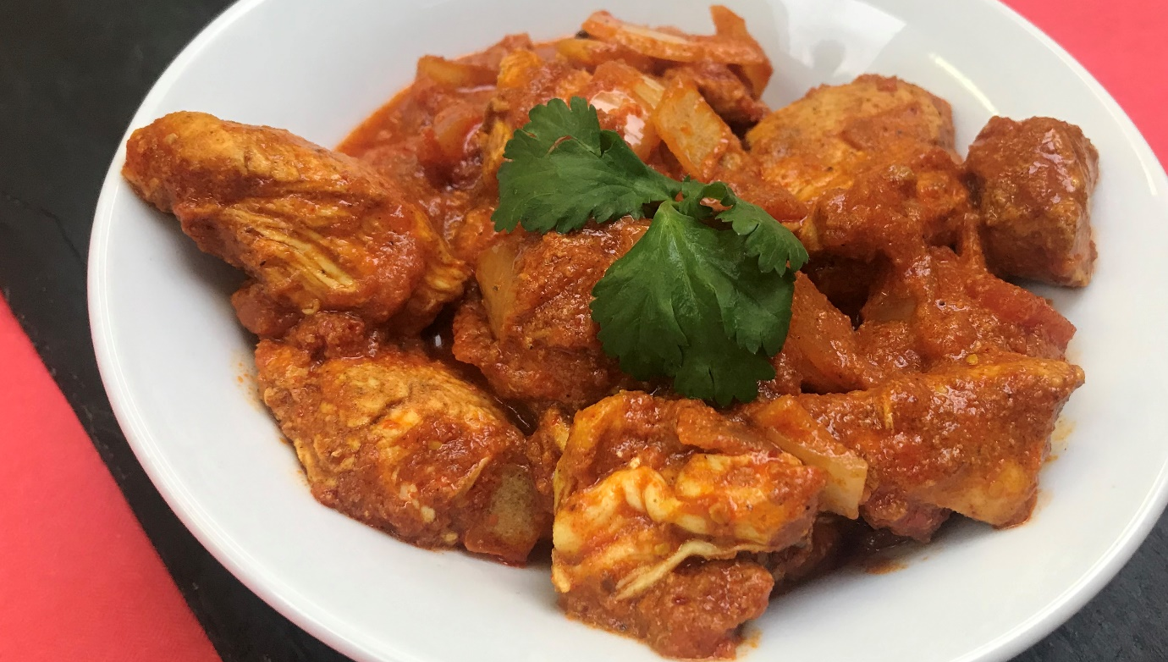
TROJANS BAR
CURRY NIGHT
LAST THURSDAY OF EVERY MONTH
ONLY £4.00

Slide 2
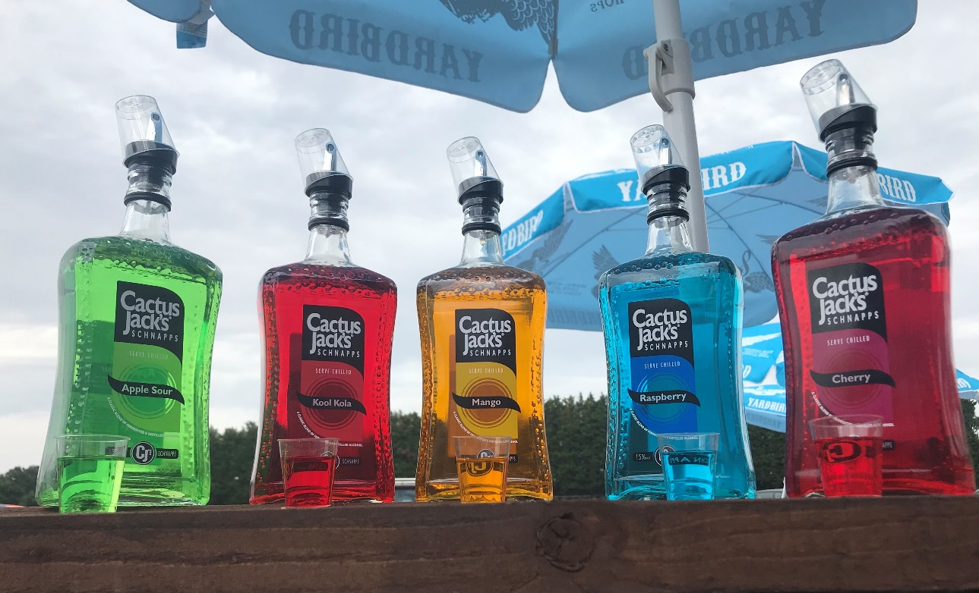
TROJANS BAR
CACTUS JACKS
VARIOUS FLAVOURS
ONLY £1.00 PER SHOT

Slide 3
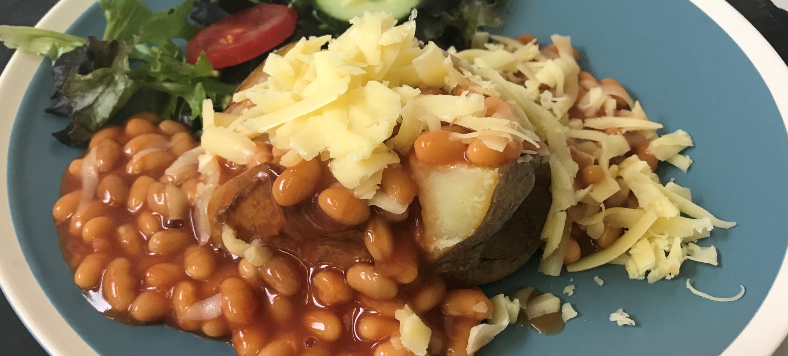
TROJANS BAR
JACKET POTATO WITH CHEESE AND BEANS
ONLY £3.50

Slide 4
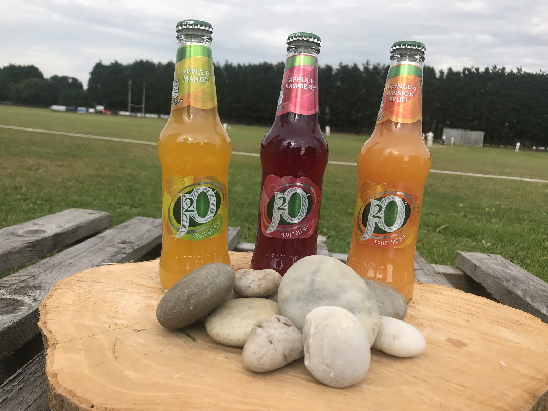
TROJANS BAR
J20
VARIOUS FLAVOURS
ONLY £2.40 PER BOTTLE

Slide 5
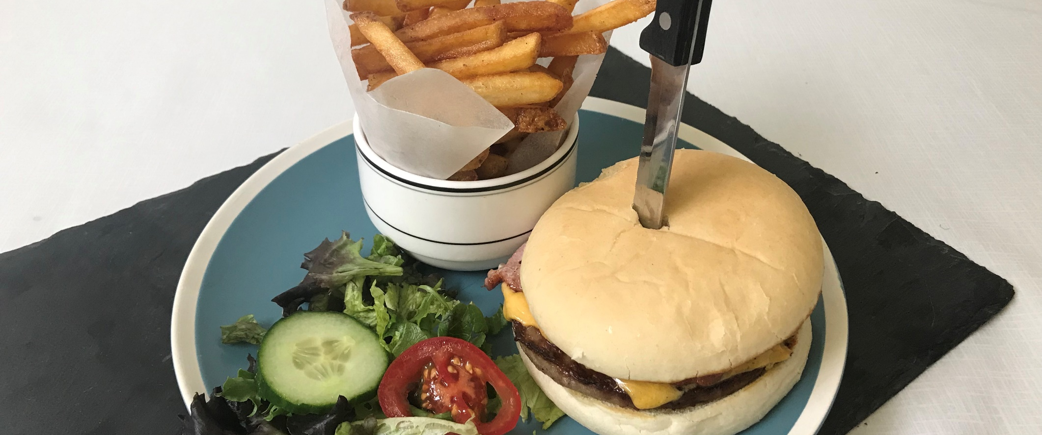
TROJANS BAR
CHEESE AND BACON BURGER WITH CHIPS
ONLY £4.50

Slide 6
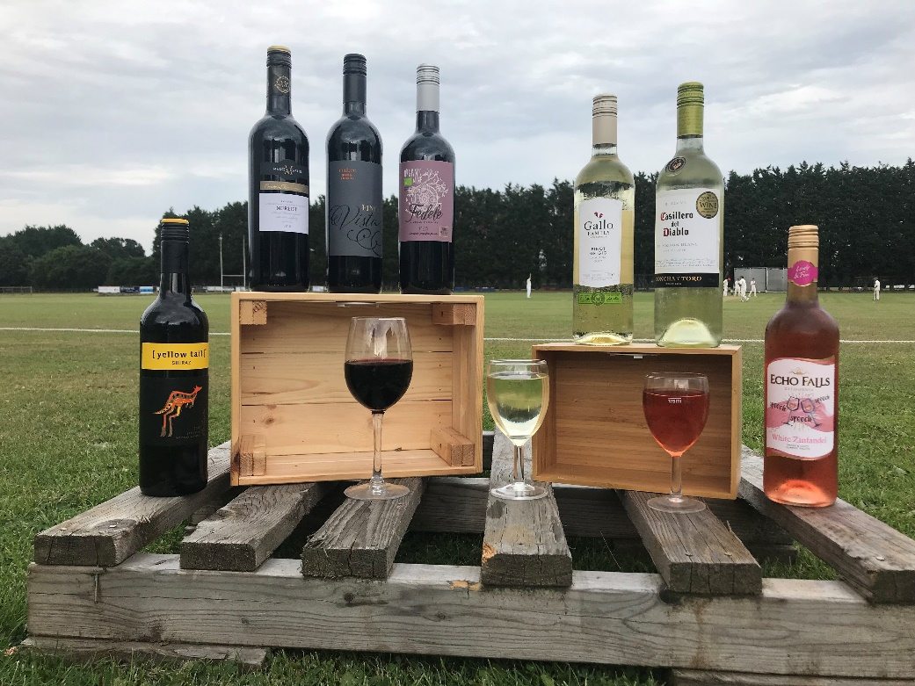
TROJANS BAR
A BOTTLE OF WINE
EVERY MONDAY AND THURSDAY
ONLY £10.00 PER BOTTLE (USUAL PRICE £12)

Slide 7
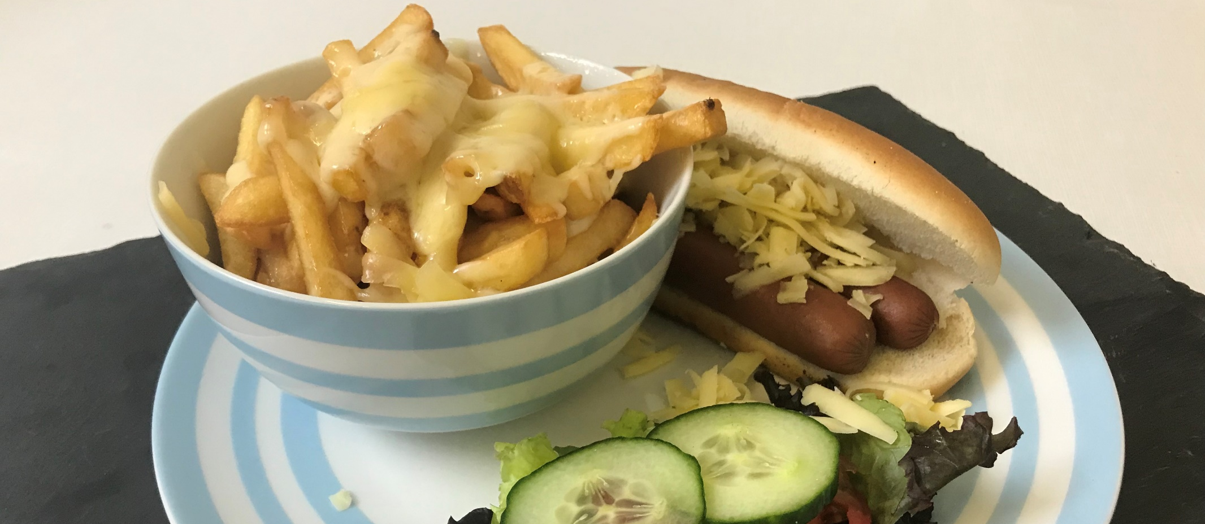
TROJANS BAR
HOT DOG WITH CHEESE AND CHEESY CHIPS
AVAIALBLE ON REQUEST

Slide 8
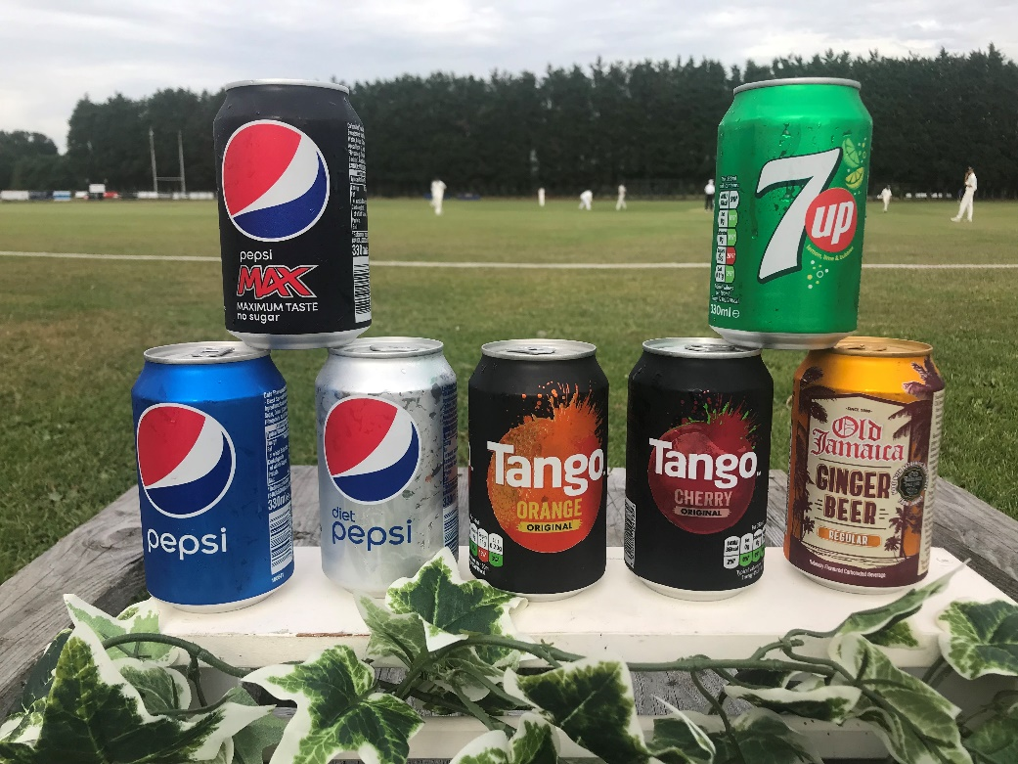
TROJANS BAR
A GREAT RANGE OF CANS
IN A VARIETY OF FLAVOURS
ONLY £1.00 PER CAN

Slide 9
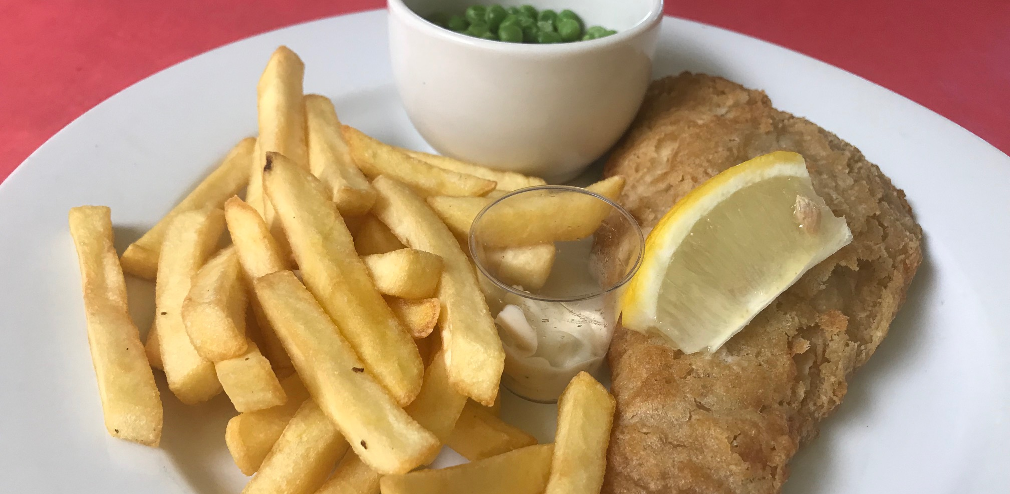
TROJANS BAR
FISH AND CHIPS ONLY £4.50
FRIDAY NIGHT IS FISH AND CHIPS NIGHT

Slide 10
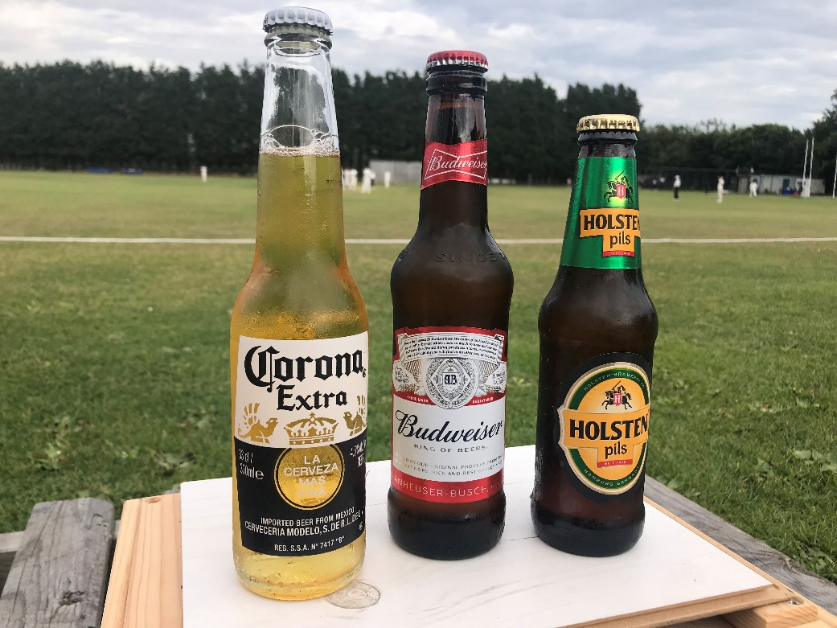
TROJANS BAR
BOTTLED LAGER
ASK ABOUT OUR CURRENT RANGE
ONLY £2.50 PER BOTTLE

Slide 11
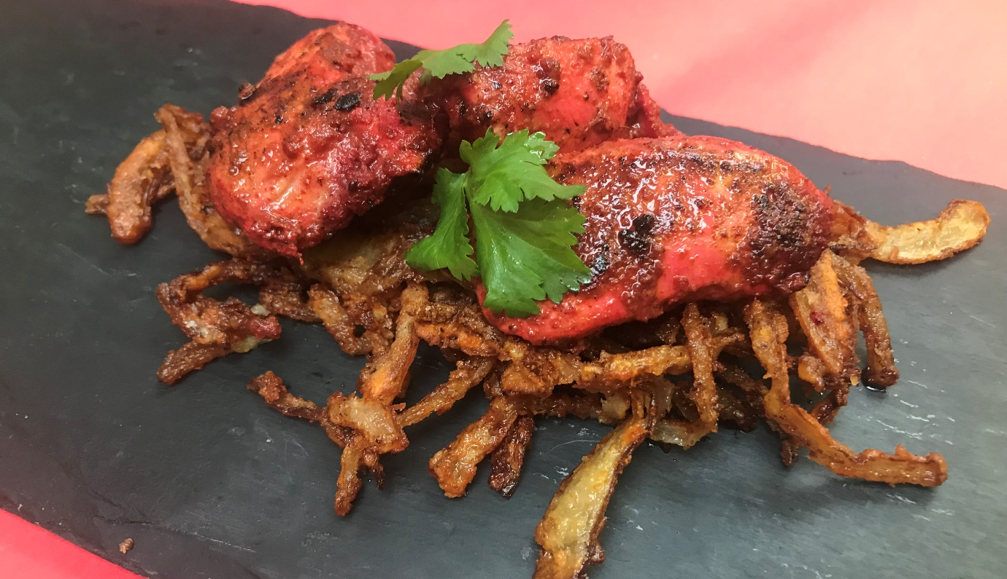
TROJANS BAR
MONDAY TO THURSDAY
TONIGHTS SPECIAL ONLY £3.00
ASK AT THE BAR WHAT OUR SPECIAL IS TONIGHT?

Slide 12
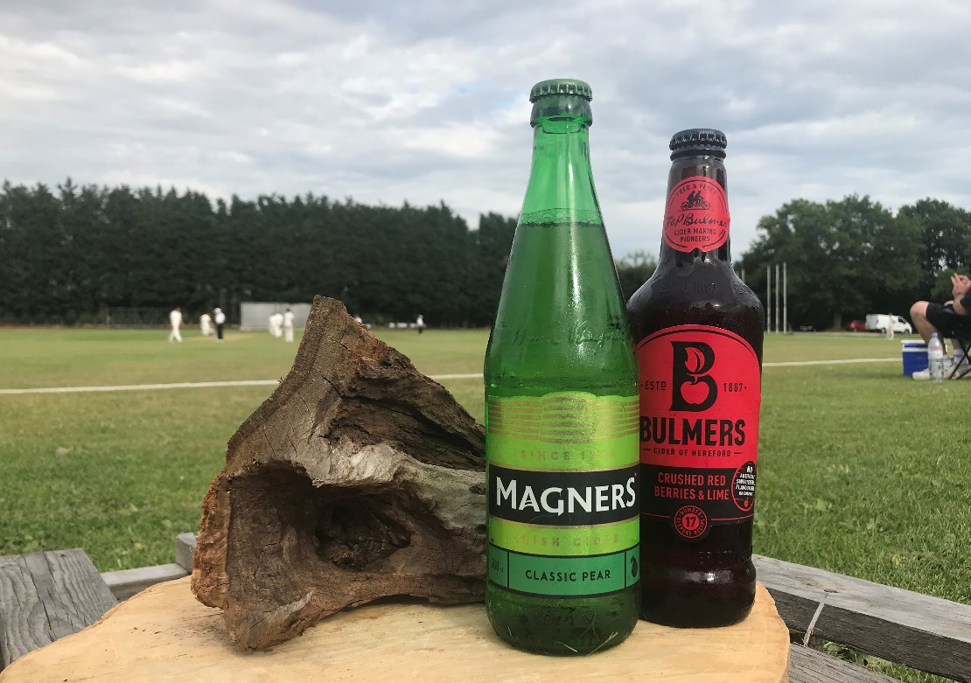
TROJANS BAR
BOTTLED CIDER
BULMERS OR MAGNERS
ONLY £3.00 PER BOTTLE

